Slide 1
The Hadoop Distributed Filesystem 4th Edition CHAPTER2 MAPREDUCE
Seung-Hyun Lim, Ga-Young Yun
2019.01.09
Database Lab.

Slide 2
Contents
Introduction
A Weather Dataset
Analyzing the Data with Unix Tools
Analyzing the Data with Hadoop
Scaling Out
Ruby & Python code
Conclusion

Slide 3
Introduction
What is MapReduce?
Programming model for data processing
Using for large datasets
Parallel Processing
Using Java, Ruby and Python

Slide 4
A Weather Dataset
Data format
Using data form National Climatic Data Center(or NCDC)
Stored using a line-oriented ASCII format
Variable data lengths.
Focusing on the temperature, which are always present and are of fixed width.

Slide 5
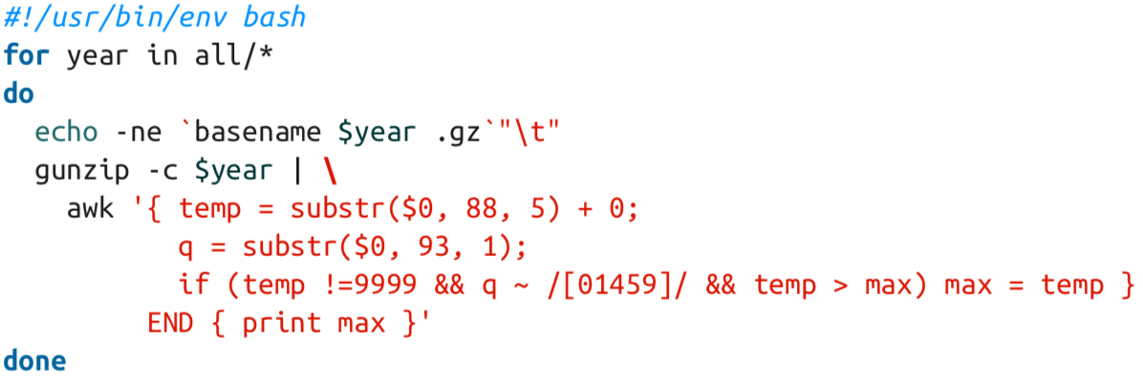
Analyzing the Data with Unix Tools
Highest temperature
The classic tool for processing line-oriented data is awk
Adding 0 in air temperature value to turn into an integer
Judging whether is valid
Judging whether the quality code indicates that the reading is not suspect or erroneous.
Having been processed all the lines in the file, END block is executed and it prints the maximum value.

Slide 6
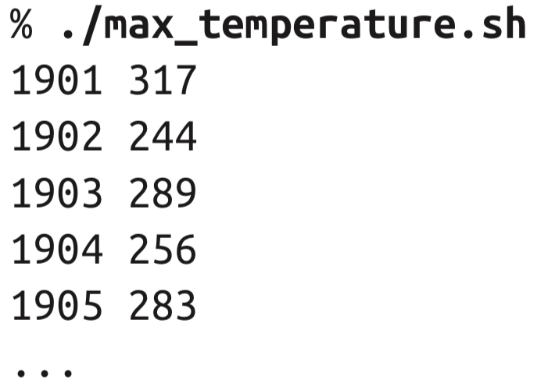
Analyzing the Data with Unix Tools (Cont’d)
Highest temperature(cont’d)
Scaled by a factor of 10 Maximum temperature of 31.7°C for 1901
Complete run for the century took 42 minutes : too long!
We need to speed up

Slide 7
Analyzing the Data with Unix Tools (Cont’d)
Parallel running
To speed up
Using all the available hardware threads on a machine, we could process different years in different processes
A few problems with this, however
Parallel running problems
Dividing the work into equal-size pieces isn’t always easy or obvious
The file size for different years varies widely so some processes will finish much earlier than others.
Even if they pick up further work, the whole run is dominated by the longest file

Slide 8
Analyzing the Data with Unix Tools (Cont’d)
Parallel running problems(Cont’d)
Combining the results from independent processes may require further processing.
Limited by the processing capacity of a single machine.
Start using multiple machines, a whole host of other factors come into play

Slide 9
Analyzing the Data with Hadoop
processing Parallel
Running it on a cluster of machines
MapReduce
Breaking the process into two phases : Map phases and Reduce phases

Slide 10
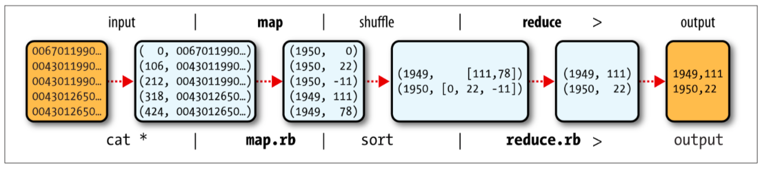
Analyzing the Data with Hadoop (Cont’d)
MapReduce
Programming model and an associated implementation
For processing and generating big data sets with Parallel and with distributed algorithm on a Cluster

Slide 11
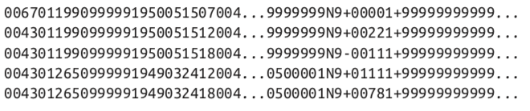
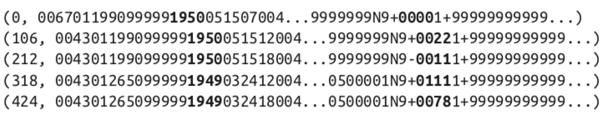
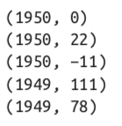
Analyzing the Data with Hadoop (Cont’d)
MapReduce (Cont’d)
Map phase
Input data
Detect &
Check valid
Key-value pair

Slide 12


Analyzing the Data with Hadoop (Cont’d)
MapReduce (Cont’d)
Reduce phase
After Map phase
Shuffled Data
Reducing
Output
The Max temperature in 1949 is 111
The Max temperature in 1950 is 22
…

Slide 13
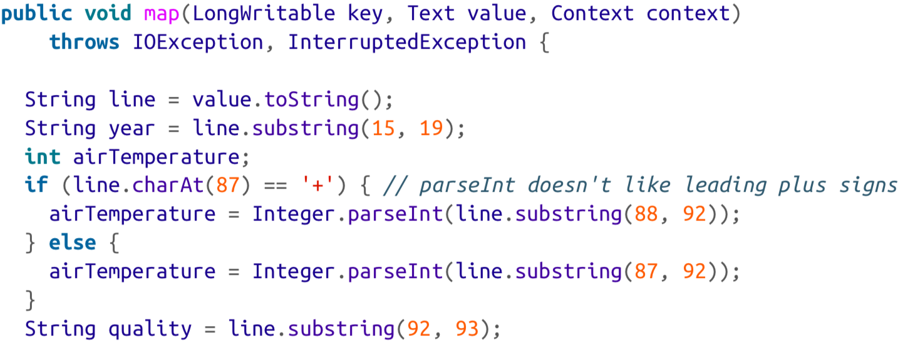
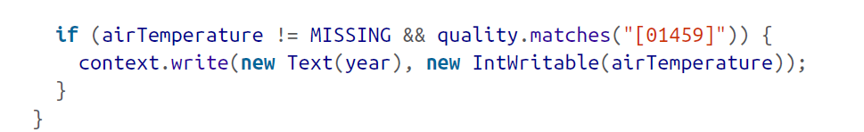
Analyzing the Data with Hadoop
Java MapReduce
Divided by 3-function : Map, Reduce, code to run the job
Map function
Notes:
코드 내에서 map의 과정이 어느어느 코드로 반영되어있는지

Slide 14
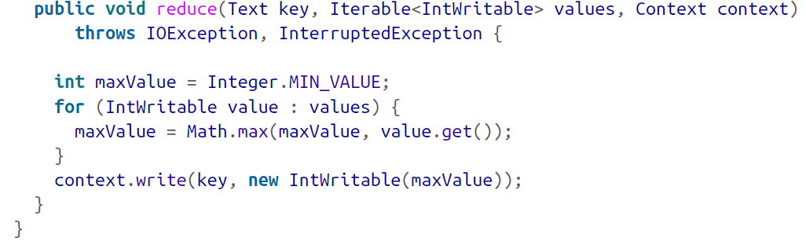
Analyzing the Data with Hadoop (Cont’d)
Java MapReduce (Cont’d)
Reduce function
Notes:
코드 내에서 reduce의 과정이 어느어느 코드로 반영되어있는지

Slide 15
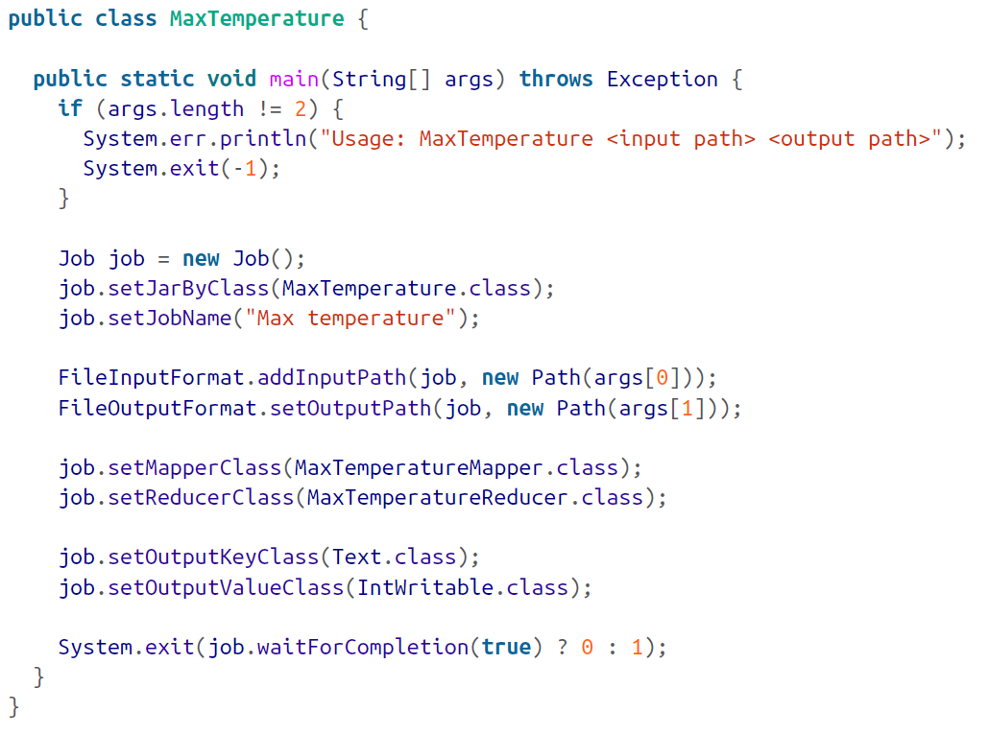
Analyzing the Data with Hadoop (Cont’d)
Java MapReduce (Cont’d)
Run the job

Slide 16
Scaling Out
Data flow for large input
Above are how MapReduce works for small input and used on the local file system
To scaling out, store the data in a distributed filesystem not in local filesystem.
Allowing Hadoop to move the MapReduce computation to each machine hosting a part of the data with YARN

Slide 17
Data Flow
MapReduce job
MapReduce = Mapping + Reducing
Hadoop divides the input to a MapReduce job into fixed-size pieces called input splits, or just splits
Hadoop creates one map task for each split
MapReduce job
split1
split2
split3
….
split n-1
split n
….
Map
Map
Map
Map
Map

Slide 18
Data Flow
MapReduce job(Cont’d)
Having many splits means each split has small time taken to process compared to the whole input’s
But too small splits result the overhead of managing it and map task creation begins to dominate the total job execution time.
Good split size is tends to be the size of an HDFS block
Data locality optimization
Hadoop does its best where the input data resides in HDFS
In this condition, hadoop doesn’t use valuable cluster bandwidth

Slide 19
Data Flow(Cont’d)
Split size is same as Block size
Split size is the largest size of input that can be guaranteed to be stored on a single node
Split spanned in two blocks
Uncertainly that any HDFS node stored both blocks
Some of the split would have to be transferred across the network to the node running the map task
Clearly less efficient than running the whole map task using local data

Slide 20
Data Flow(Cont’d)
Map task
Write their output to the local disk, not to HDFS
Map output is intermediate output
Storing it in HDFS with replication would be overkill
Hadoop automatically rerun the map task on another node If the node fails before the map output has been consumed by the reduce task

Slide 21
Data Flow (Cont’d)
Reduce task
No advantage of data locality
Single reduce task
Map outputs are sorted and merged and then, passed to single reduce function
Output of the reduce is normally stored in HDFS for reliability

Slide 22
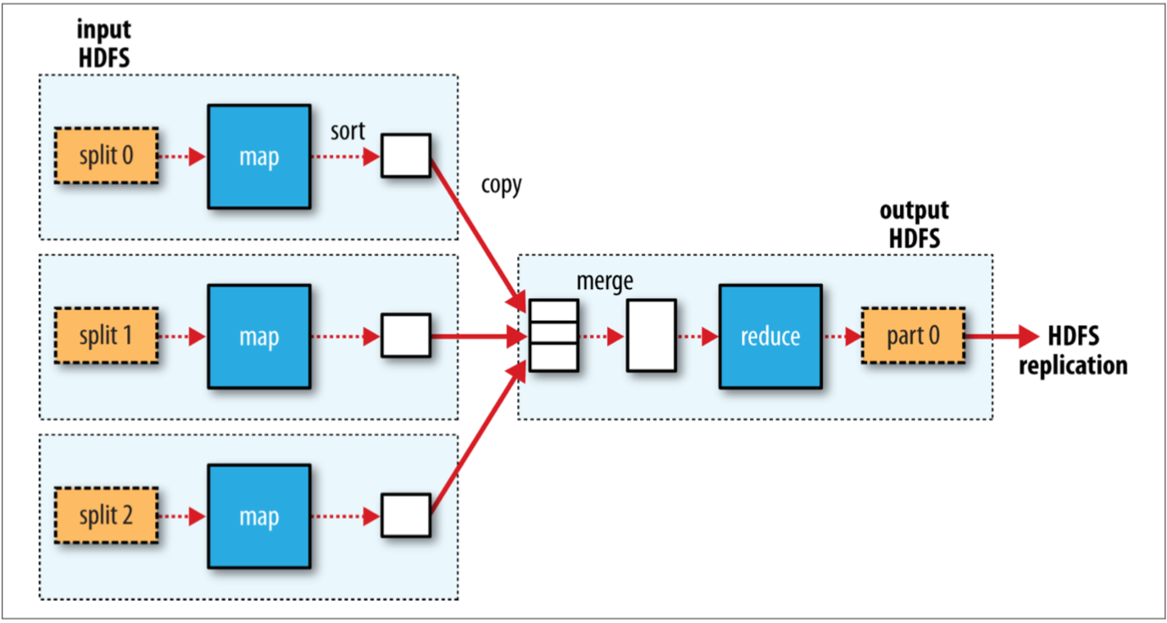
Data Flow (Cont’d)

Slide 23
Data Flow (Cont’d)
Multi reduce task
Reduce task’s number is specified independently
The map tasks partition their output and each creating one partition for each reduce task

Slide 24
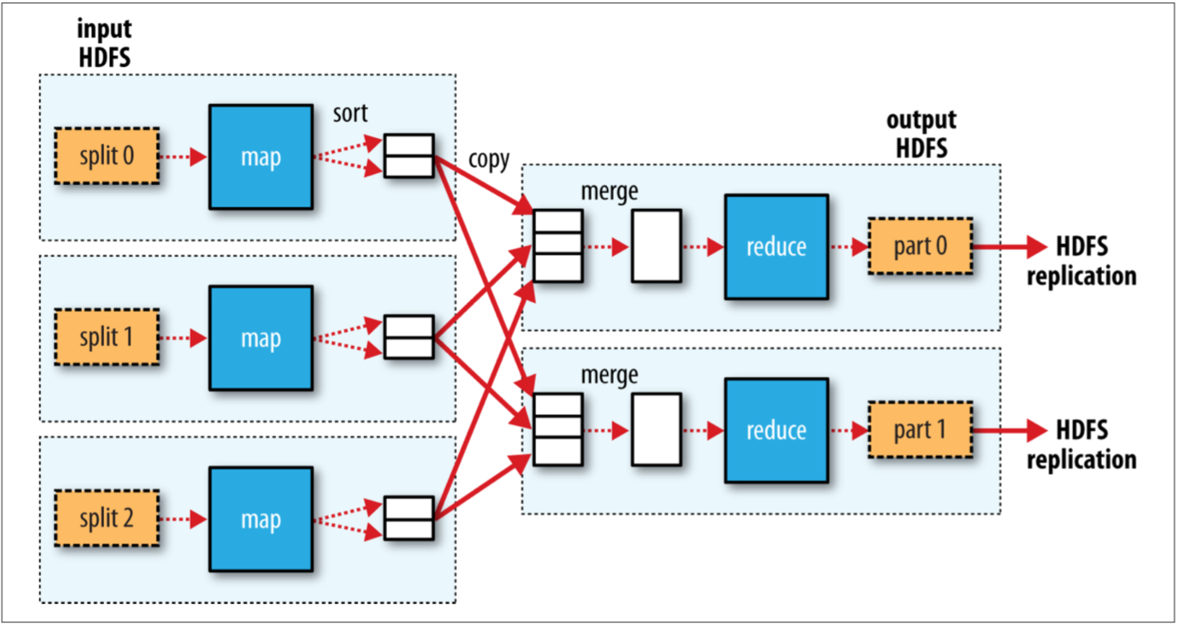
Data Flow (Cont’d)
Multi reduce task(Cont’d)
Reduce task is fed by many map tasks
This diagram makes it clear why the data flow between map and reduce tasks is known as “the shuffle”

Slide 25
Scaling Out
Combiner Functions
An optional Processing like a semi-reducer
Accepting the inputs from the Map class
Passing the output key-value pairs to the Reducer class
Minimizing the transferred data between map and reduce tasks (used for optimization)
Importance of optimization :
Many MapReduce job are limited by Bandwidth available on the cluster

Slide 26
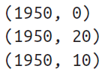


Scaling Out (Cont’d)
Combiner Functions (Cont’d)
Combiner Functions Summarize the map output records with the same key
Combiner Functions reduce the volume of key-value collection to send over the network

Slide 27
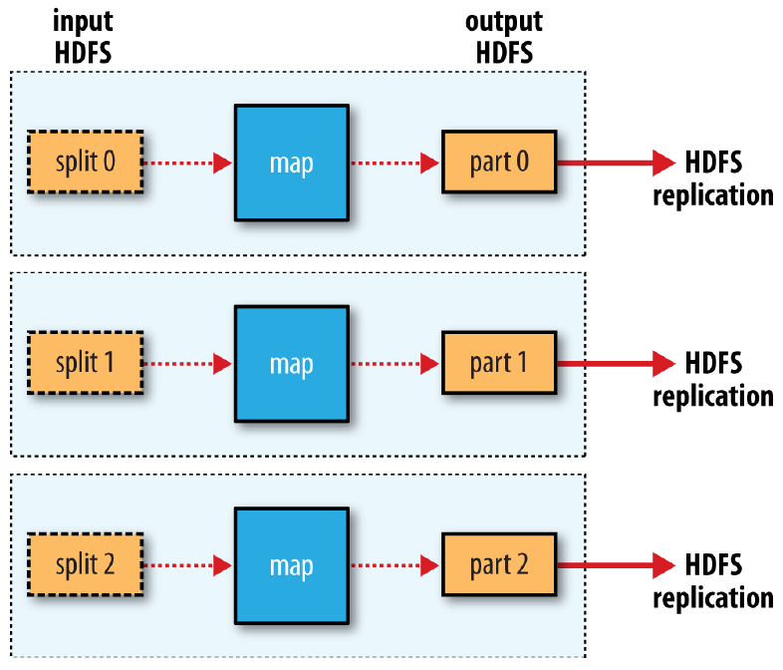
Scaling Out (Cont’d)
Combiner Functions (Cont’d)
Possible to replace the Reducer,
if there is no reduce tasks

Slide 28



Scaling Out (Cont’d)
Combiner Functions (Cont’d)
Some problem about replacing the reduce function
Correct
Processing
InCorrect
Processing
1st produced
2nd produced

Slide 29
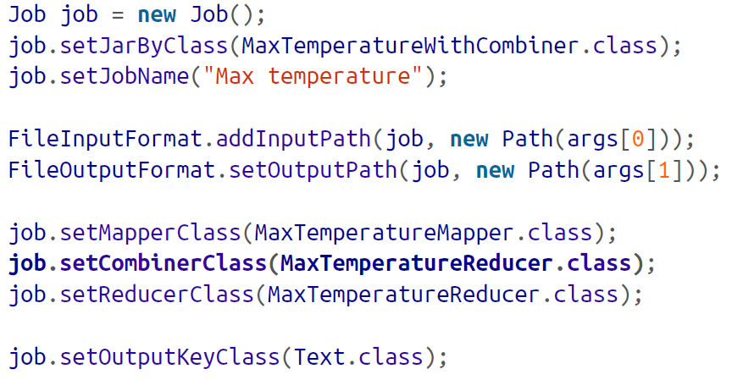

Scaling Out (Cont’d)
Specifying a Combiner Functions
Using the Java MapReduce program, the combiner function
is defined in the Reducer class

Slide 30
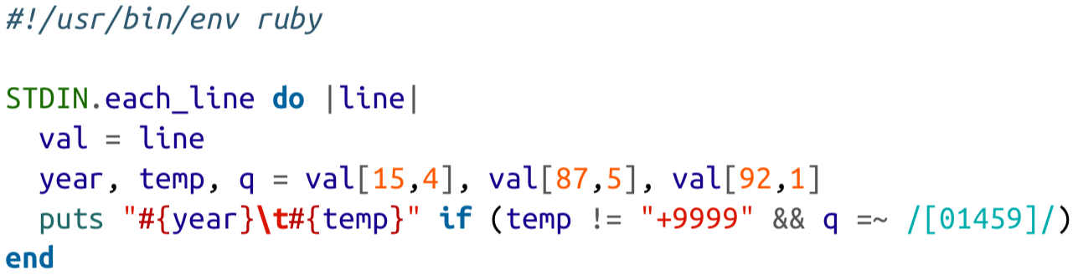
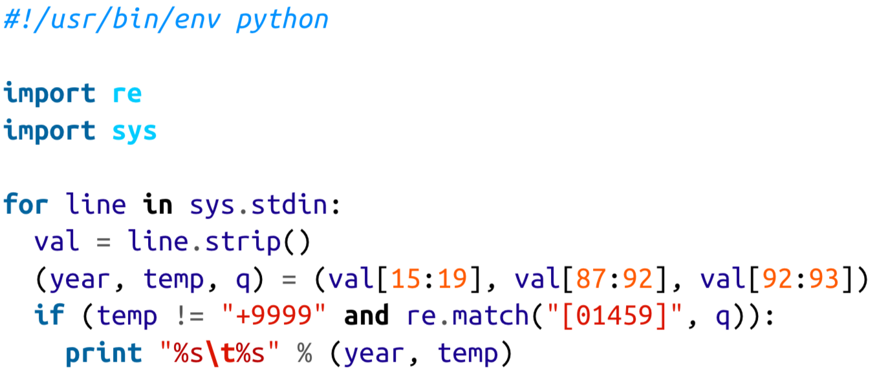
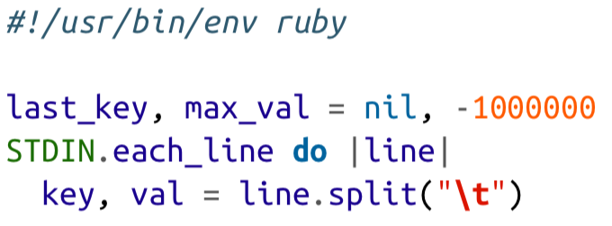
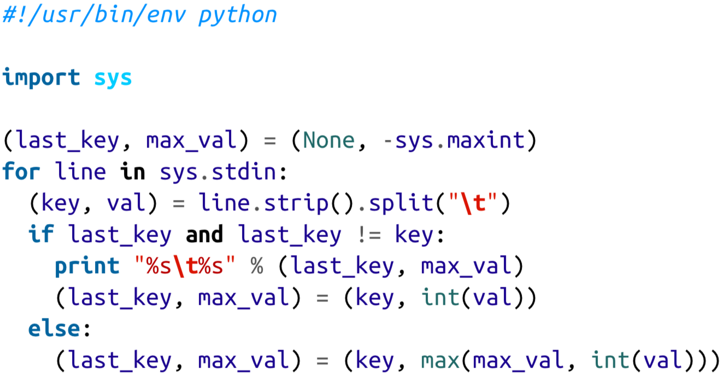
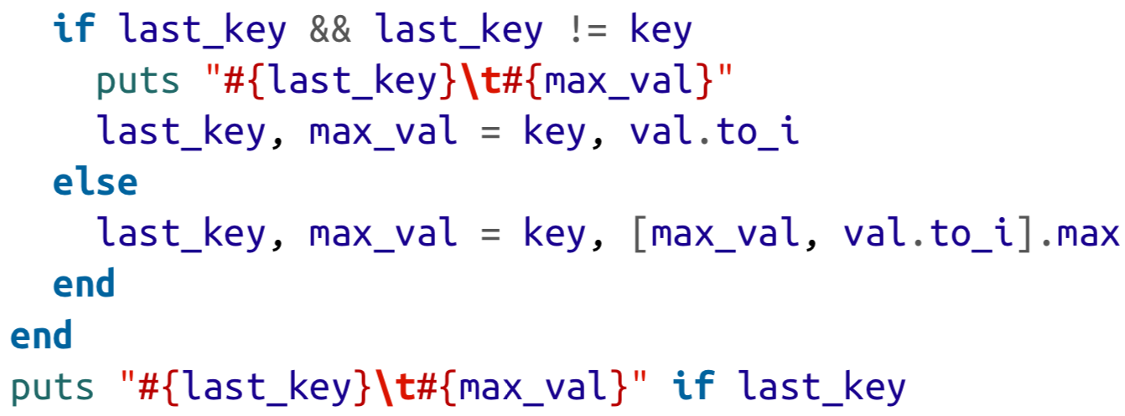
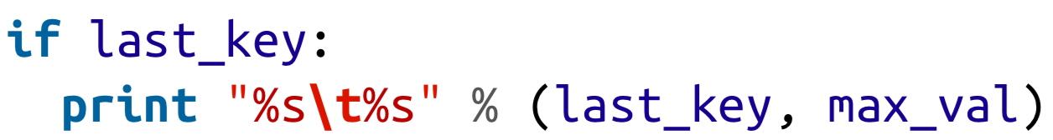
Ruby & Python
Hadoop streaming (MapReduce API)
Interface between Hadoop and program (using Unix standard)
Suited for text processing
Ruby code Python code

Slide 31
Conclusion
Hadoop is more efficient than Unix tools at Analyzing and Processing the Data
Parallel processing
Running on a cluster of machines
MapReduce
Scaling out in Hadoop filesystem
Three types of dataflow
Combiner Function

Slide 32
Q&A
Thank you ☺

